Slide 1

Exploring the world of pets in mexico march 2024
Jose Juan Lopez

Slide 2
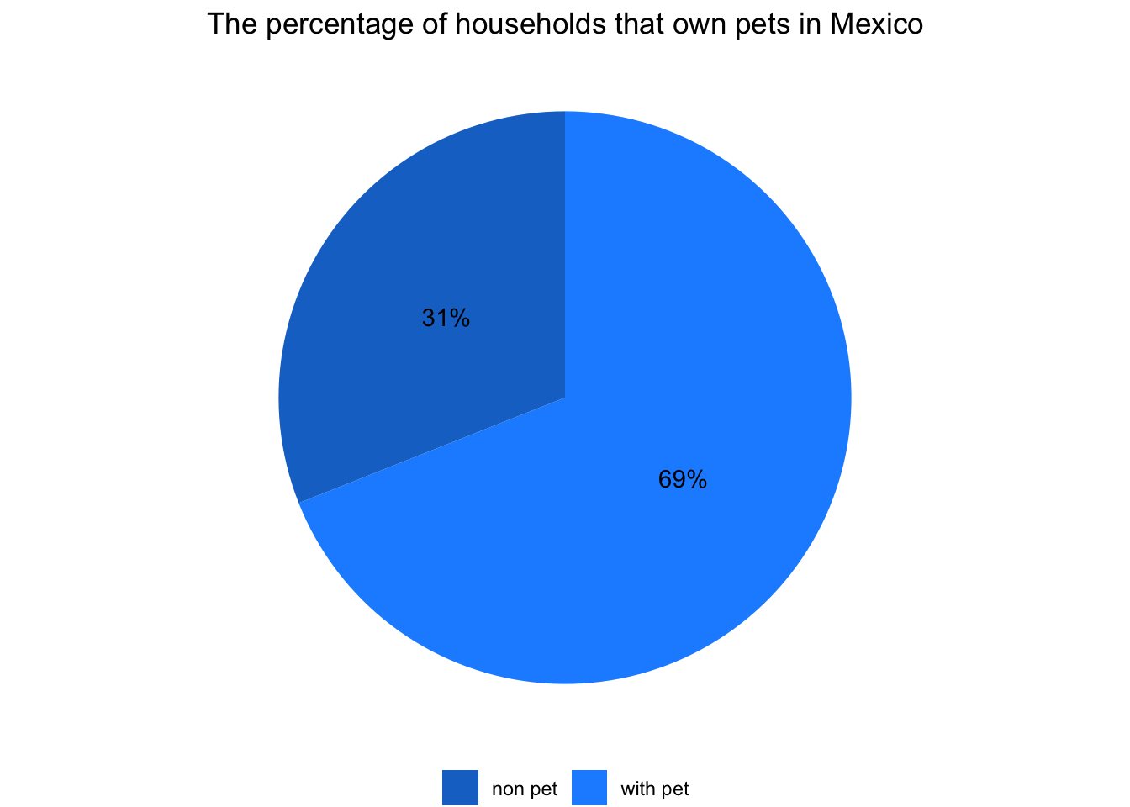
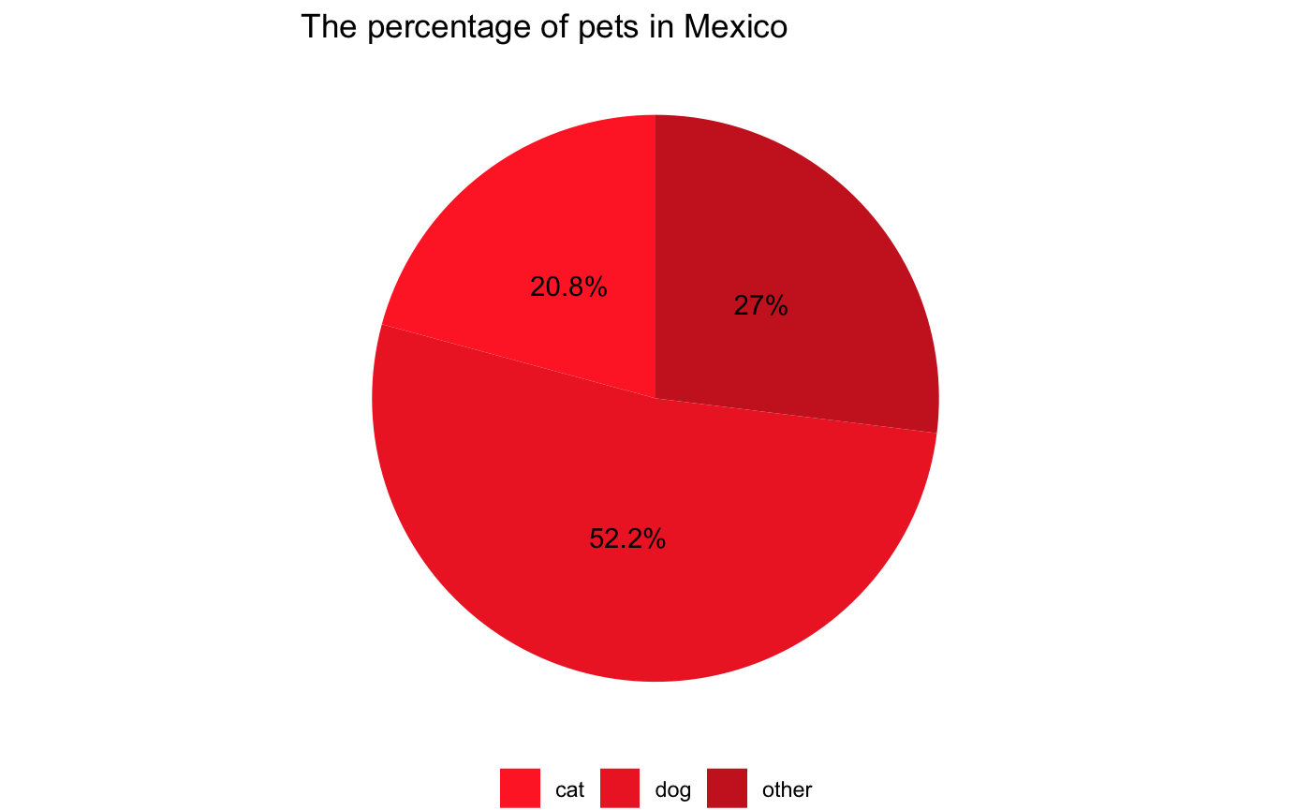
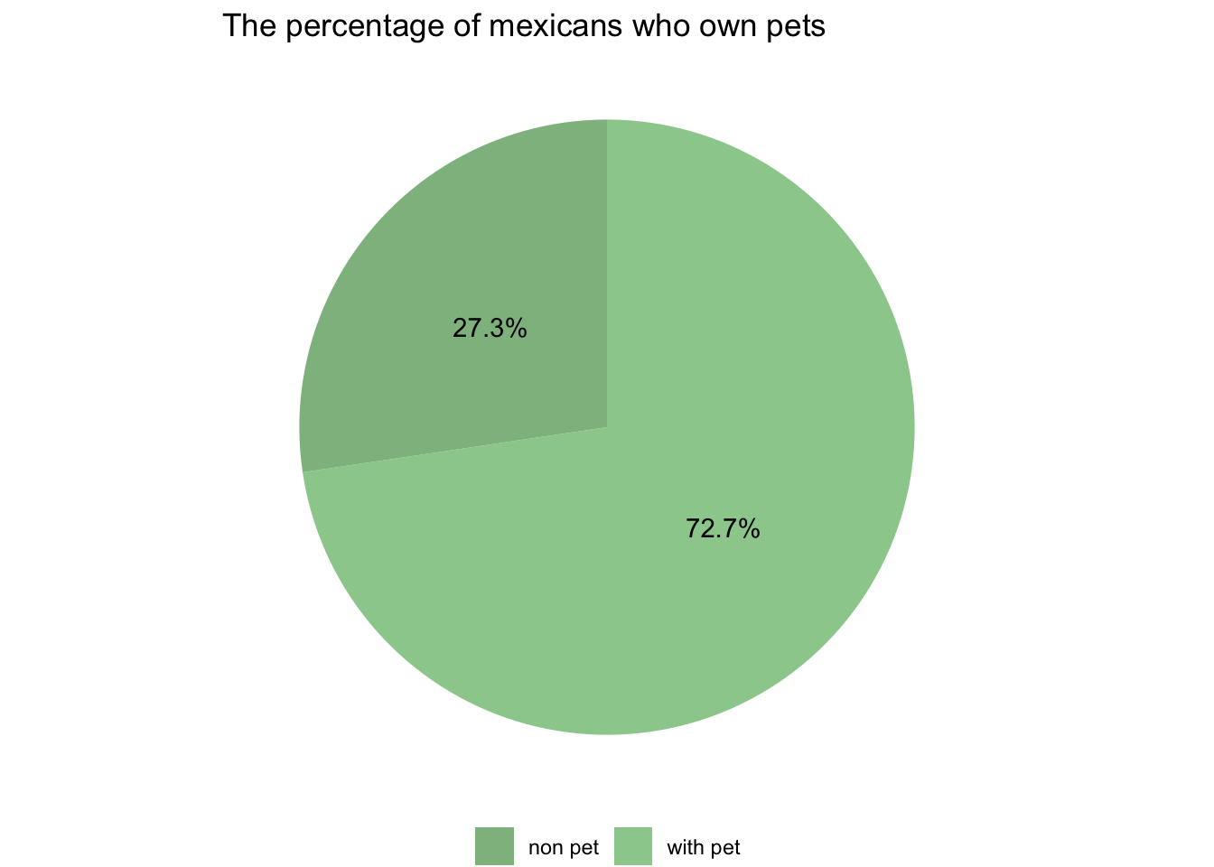
Watching the human-animal bond
Non pet: 66,159,188
With pet: 24,897,273
Non pet: 11,909,487
With pet: 26,508,923
Cat: 18,986,535 Dog: 47,711,365
Other: 24,617,509

Slide 3

My love is unconditional

Slide 4
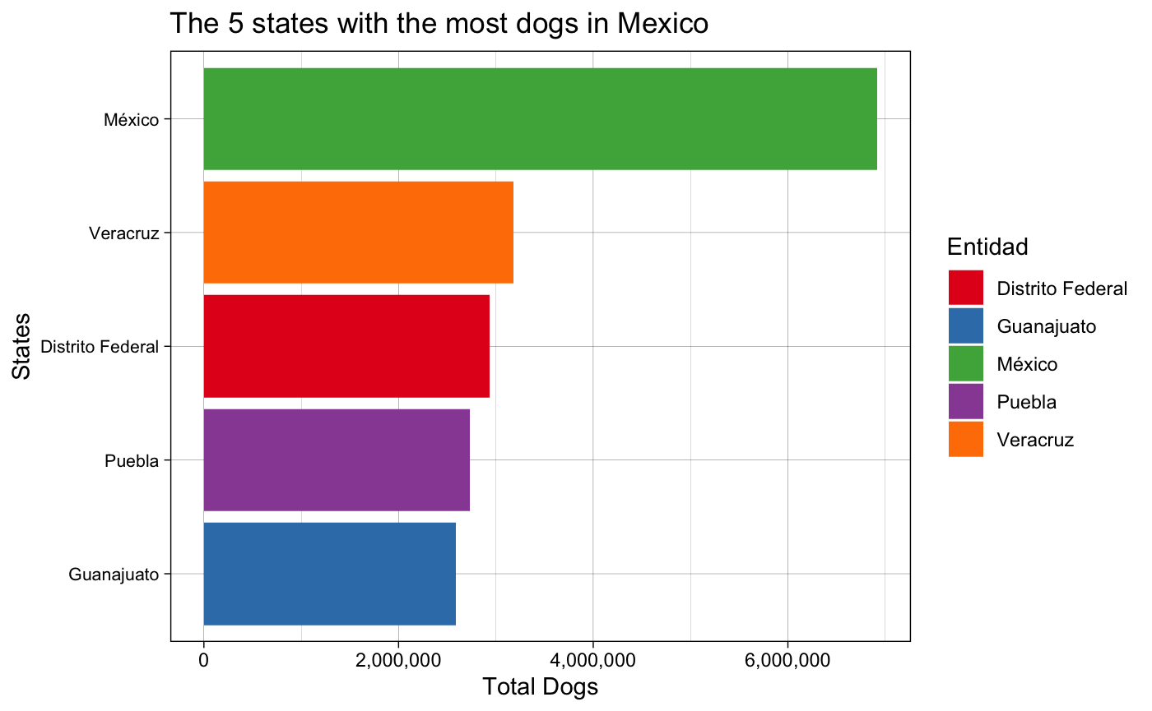
States total
México 6,919,036
Veracruz 3,176,730
Distrito Federal 2,932,109
Puebla 2,729,657
Guanajuato 2,586,713

Slide 5
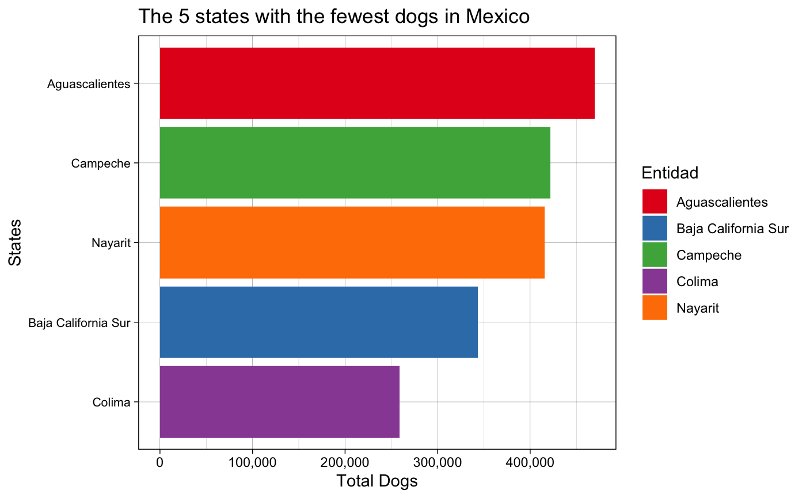
States total
Aguascalientes 469,627
Campeche 421,802
Nayarit 415,563
Baja California Sur 343,590
Colima 258,895

Slide 6

My love is based on ignoring you

Slide 7
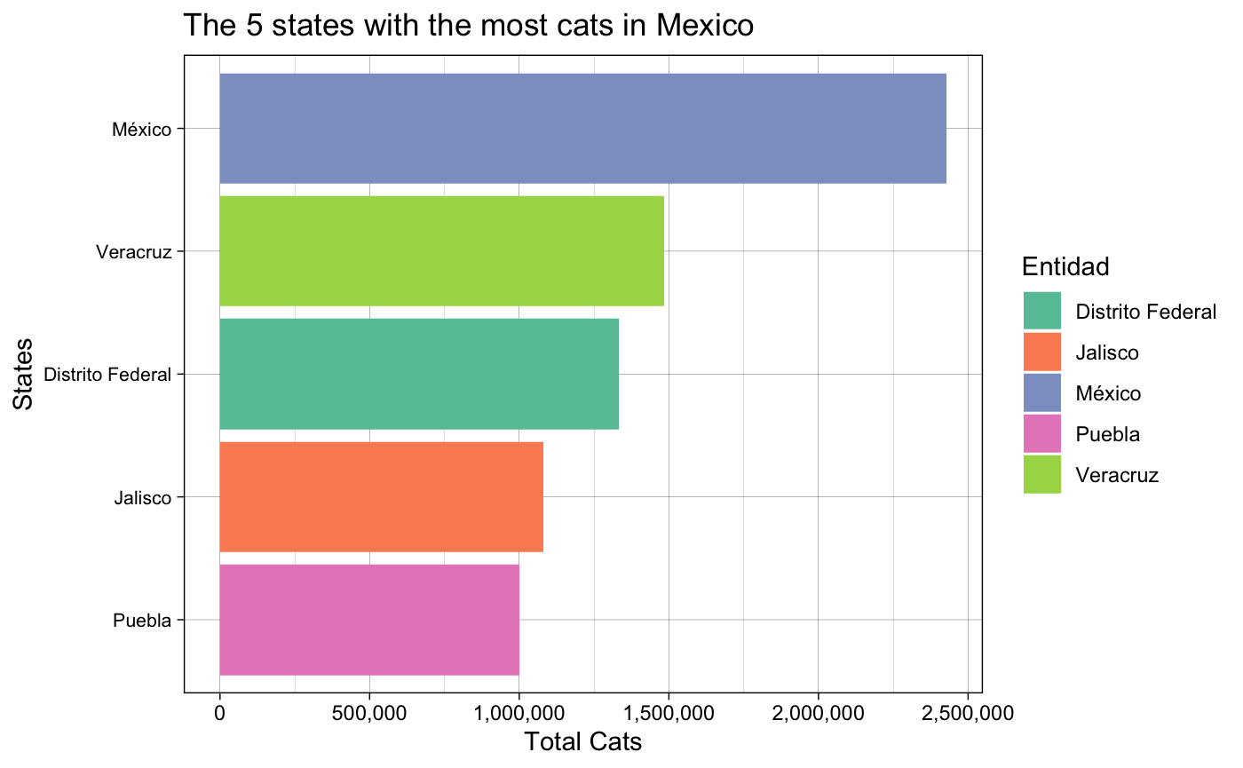
States total
Mexio 2,428,373
Veracruz 1,483,856
Distrito Federal 1,333,369
Jalisco 1,079,193
Puebla 999,402

Slide 8
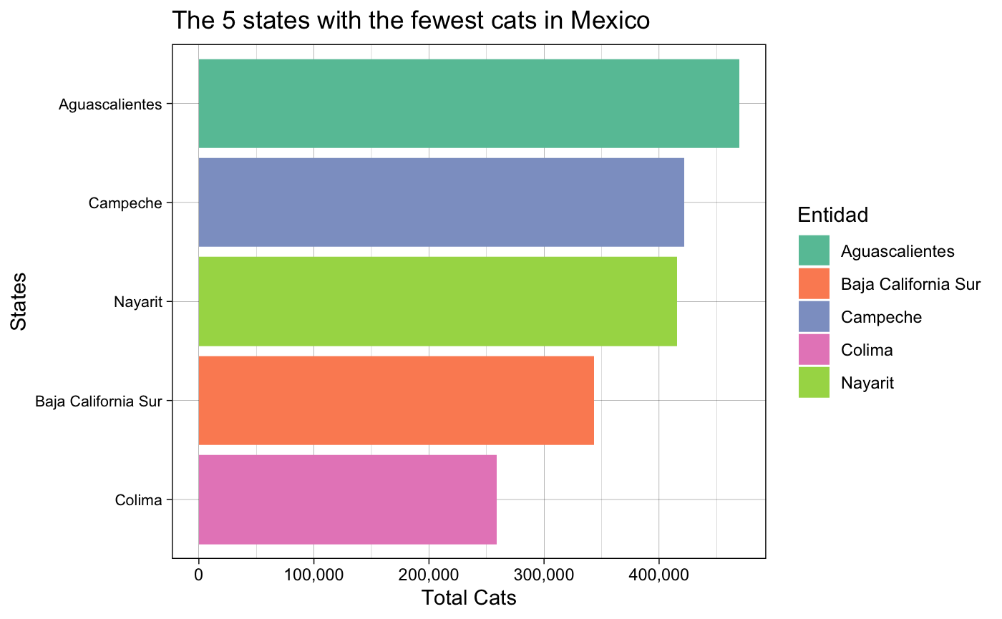
States total
Aguascalientes 469,627
Campeche 421,802
Nayarit 415,563
Baja California Sur 343,590
Colima 258,895

Slide 9
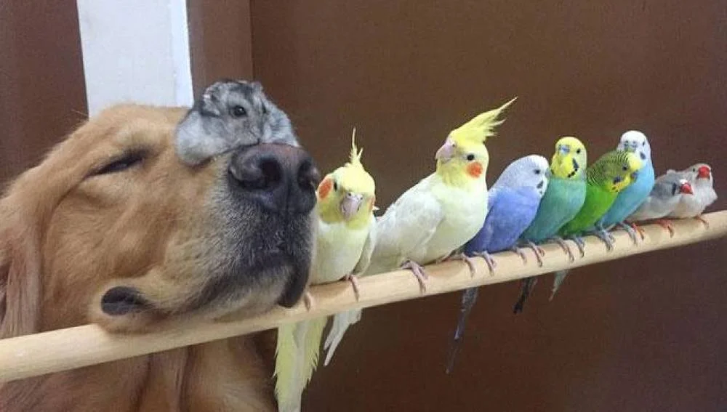
Even the smallest of animals is a masterpiece

Slide 10
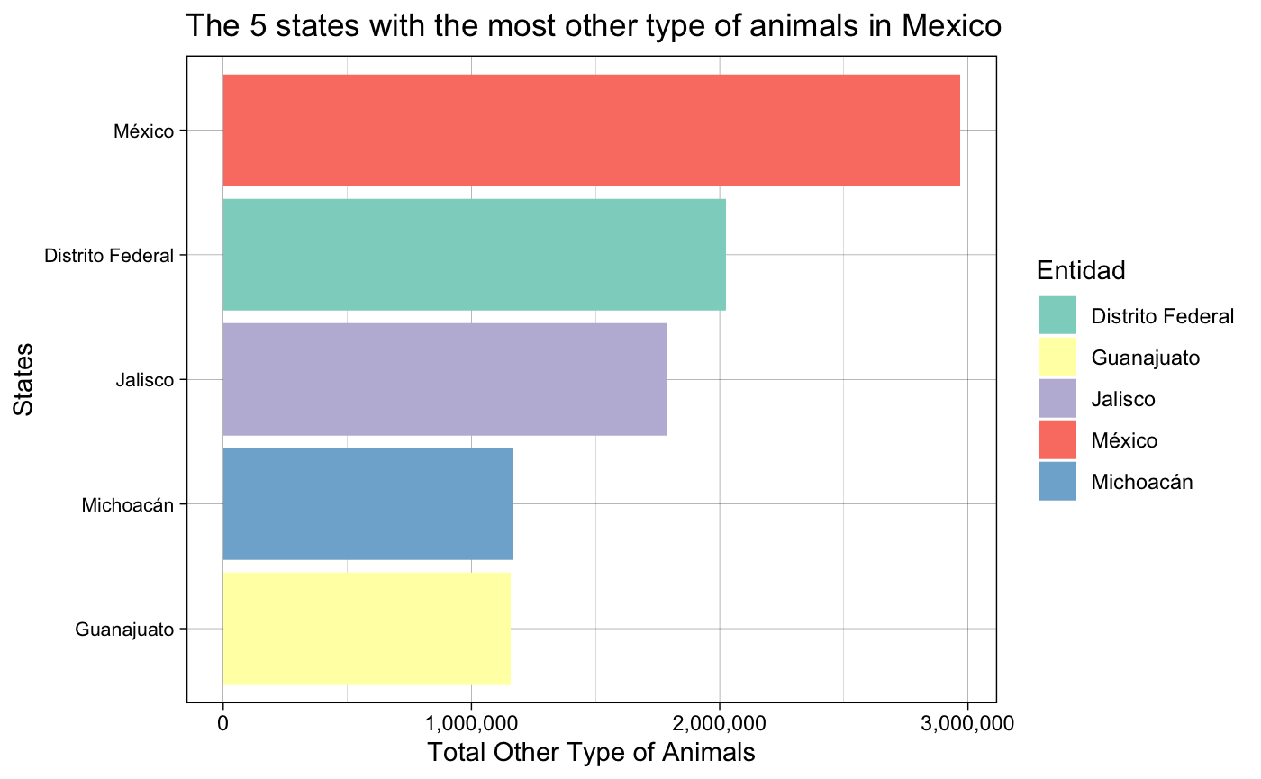
States total
México 2,969,425
Distrito Federal 2,026,476
Jalisco 1,785,147
Michoacan 1,168,286
Guanajuato 1,156,618

Slide 11
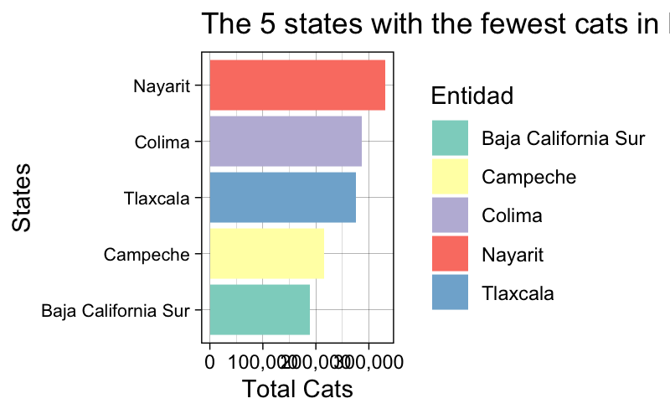
States total
Nayarit 331,083
Colima 287,411
Tlaxcala 275,664
Campeche 216,301
Baja California Sur 188,203

Slide 12
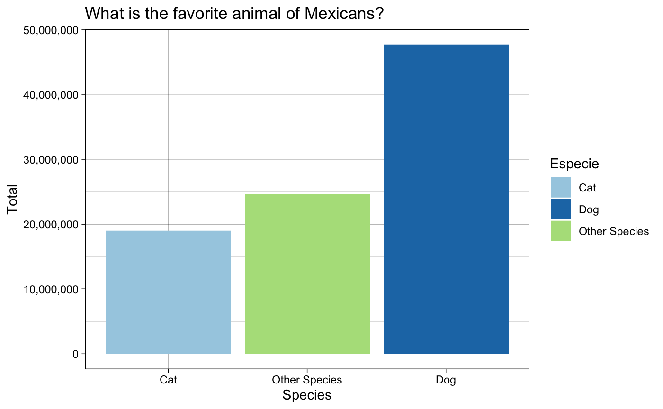
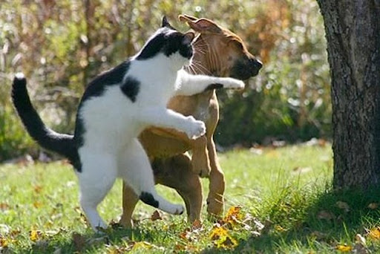
Who wins the battle?
States total
Dog 47,711,365
Other specie 24,617,509
Cat 18,986,535

Slide 13
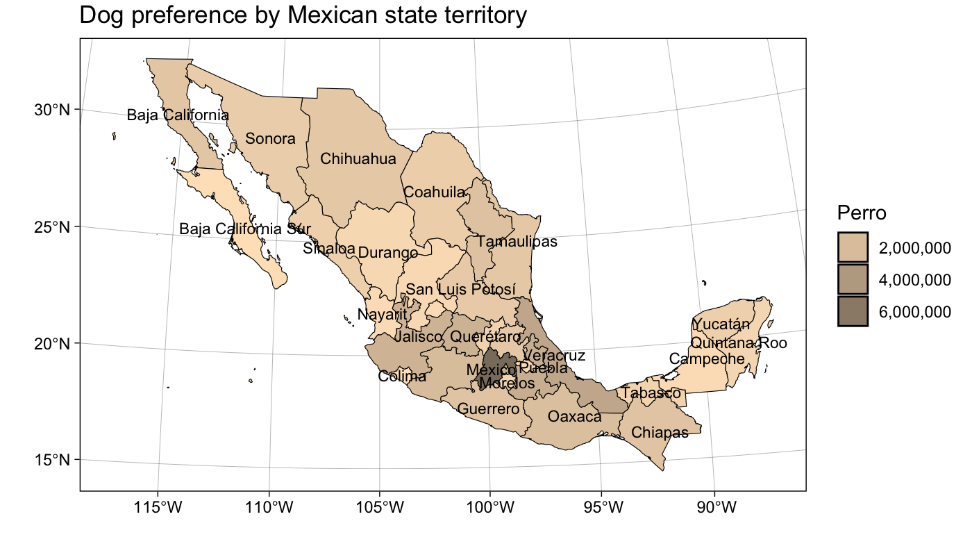

Slide 14
Thanks!

